Slide 1
Flight Price Predicton Project Using ML Algorithms
Submitted By:- Sujay Nimbalkar
Submitted To:- Swati Mahaseth
Date:- 27/02/2022

Slide 2
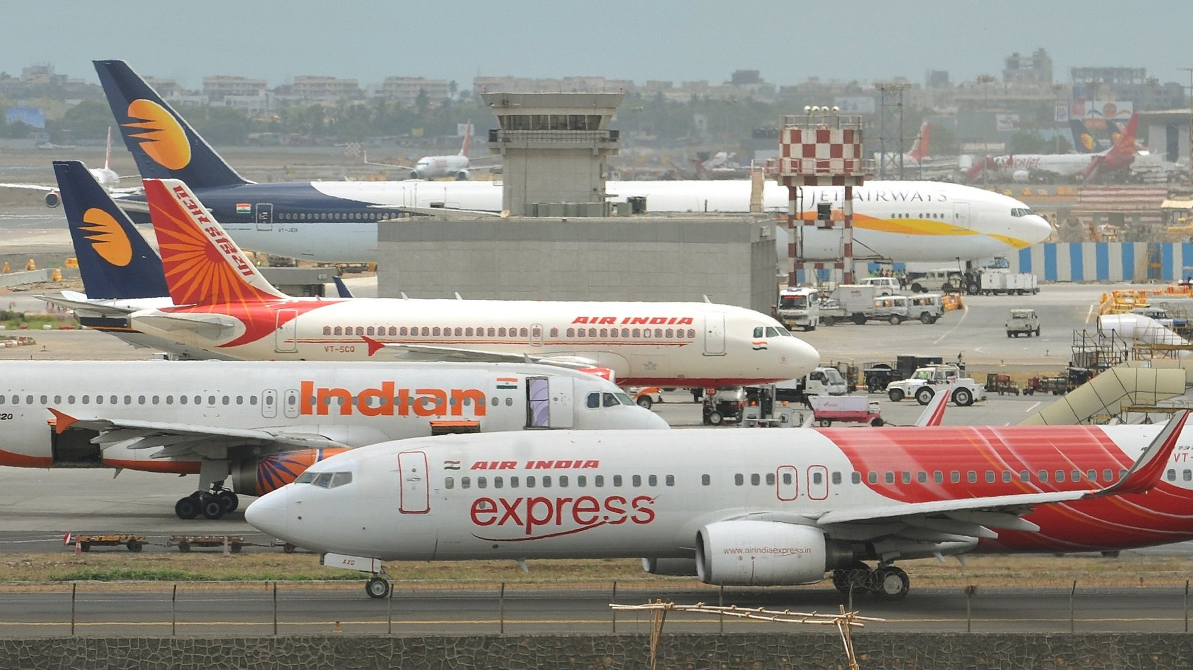

Slide 3
Data scrapping Done from Yatra.com
To work on this project we have explored various websites like Goibibo,Trivago,MMT, Yatra etc…
Finally we scrapped the data from the Yatra.com

Slide 4
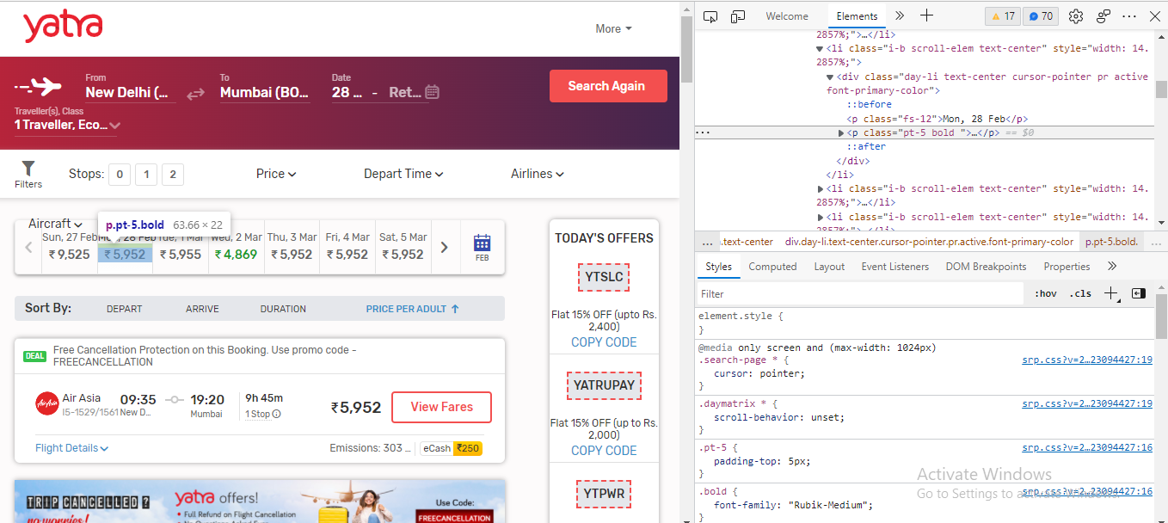

Slide 5
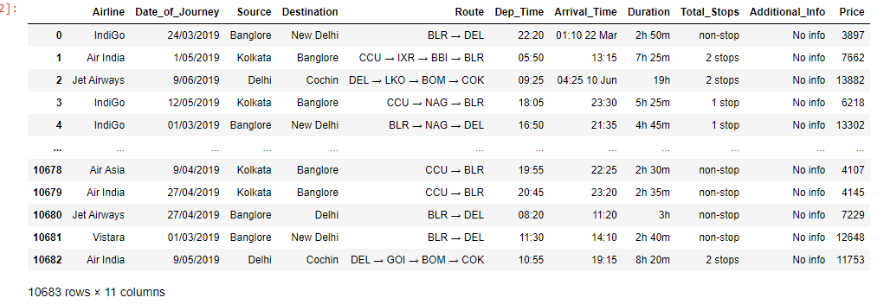
Scrapping the Data and created a Data Frame. As we can see in the picture we have 10683 rows and 11 columns

Slide 6
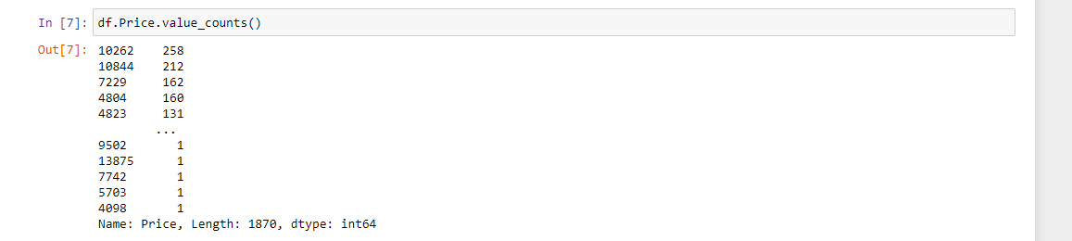
Identifying the Problem
Here in the Data set we can see that the price is the dependant variable which is in the continuous nature Hence the problem is linear Regression Problem.

Slide 7
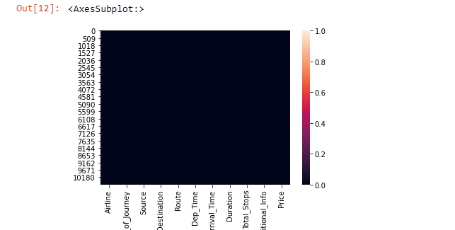
EDA Checked for the data types, columns & Null values
We have plotted a heat map to check the Null values in the Data set but as there are only few Null values in the Data Set we cannot see them in the Heat map.

Slide 8
Statistical Summary
After the Statistical Summary we have sevral Observations like
All the Columns are in the string format hence we cannot analyse them.
There is difference between the mean & median
Huge difference is seen in max and 75% which results that outliers are present.
So we need to convert all the columns in the integer format.

Slide 9
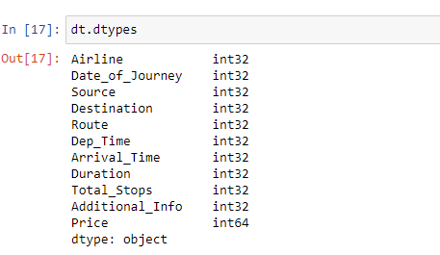
Label Encoding
By importing the necessary library we have done the label encoding to convert all the columns into integer format

Slide 10
Univaraite Analysis
In this analysis we have checked with all the parameters we came to know about the outliers present.
We have used box plot for this to plot and check.
Finally we came to the conclusion looking at the plots that there are extreme outliers present.

Slide 11
Biavariate Analysis
For Bivariate Analysis we have used scatter plots to check the relation of each columns with the target column.

Slide 12
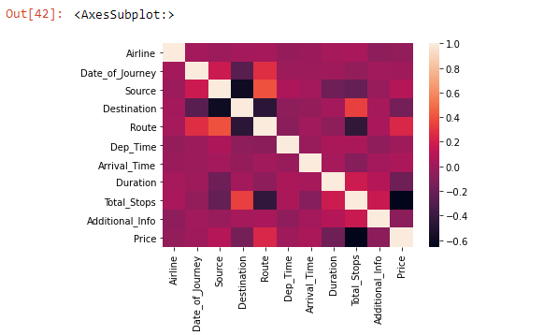
Multivariate Analysis
We have done Multivaraite Analysis to check the co-relation
We have also plotted the heat Map to observe
Here the light shades are highly co-related.

Slide 13
Observations
Here the light shades are Highly co-related
We can also see that total stops columns is negatively co-related with the target column.
Route column is positively co-related with the target column.
Source,arrival time and some other columns are also positively co-related with the target column.

Slide 14
Checking the skewness
We have also checked for the skewness present in each columns by plotting dist plots.
Skewness is present in the curves as seen in all the columns.

Slide 15
Data cleaning
Data cleaning removed the unnecessary Data from the data set which is not required
We also removed the null values form the data set.

Slide 16
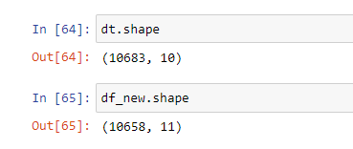
Removing the outliers
Removed the outliers using scipy.stats importing the zscore.
So first we had 10683 rows and 10 columns
Now the shape of the data set have 10658 rows and 11 columns of the new dataset,we have deleted 25 rows.

Slide 17
Further the data was checked to remove the skewness in dataset but there is no skewness hence the data undergone for the train test split and lastly we found the best algorithm using the best model using all the important libraries which were required and got our best model

Slide 18
Thank you

